Slide 1


Nivash Singh, Sashen Reddy, Sive Koto, Selina Naidu

Slide 2
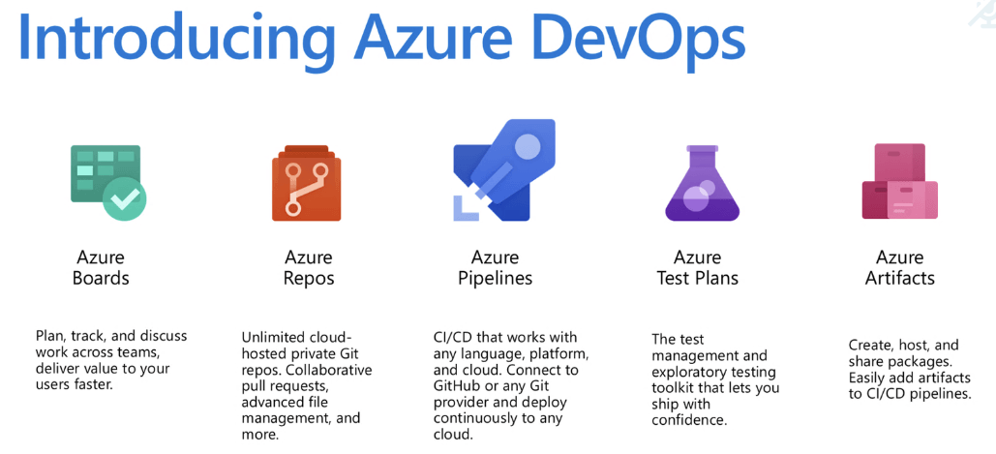

Slide 3
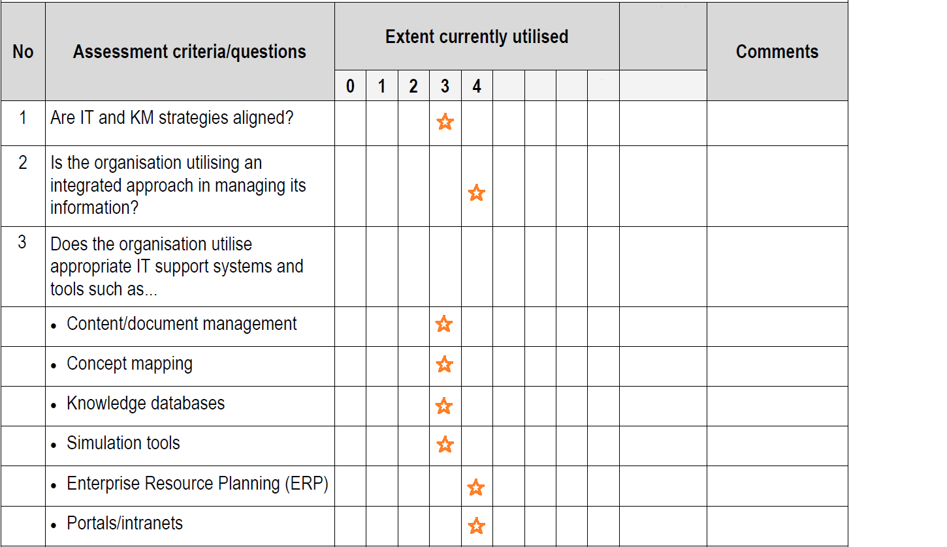
Assessment

Slide 4


Strengths & Weakness
Ensure faster deployment. ...
Stabilize work environment. ...
Significant improvement in product quality. ...
Automation in repetitive tasks leaves more room for innovation. ...
Promotes agility in your business. ...
Continuous delivery of software. ...
Fast and reliable problem-solving techniques.
No connection to Pluralsight flow on premises
Only works on Windows OS

Slide 5
Suggestions
No connection to Pluralsight flow on premises
Only works on Windows OS
Move to Cloud based on the fact that its currently used on premises
Repo Backups

Slide 6
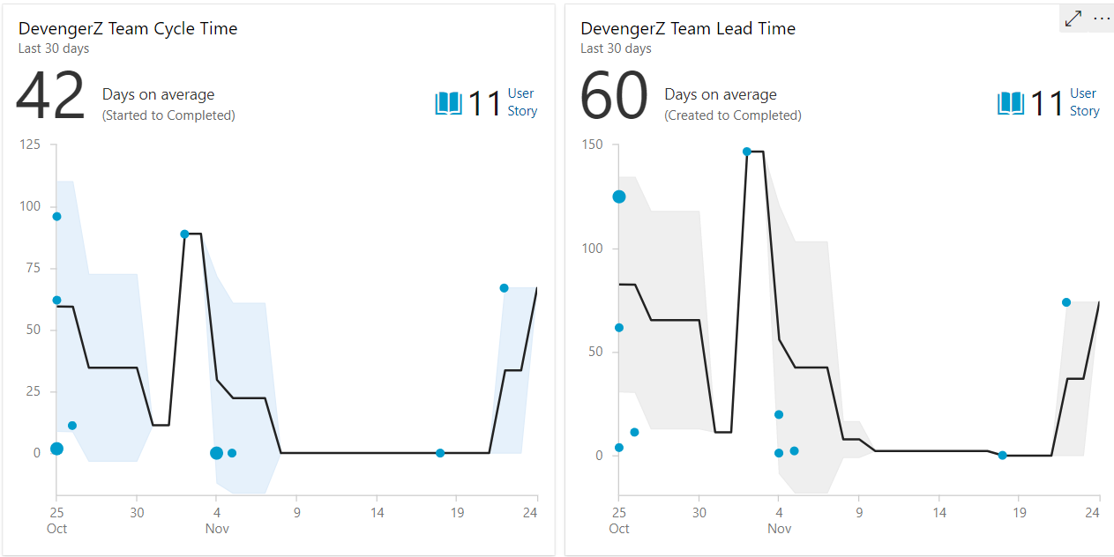
Performance Measurement

Slide 7
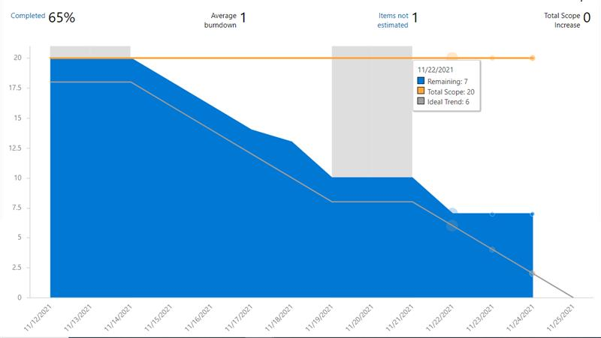
Performance Measurement

Slide 8
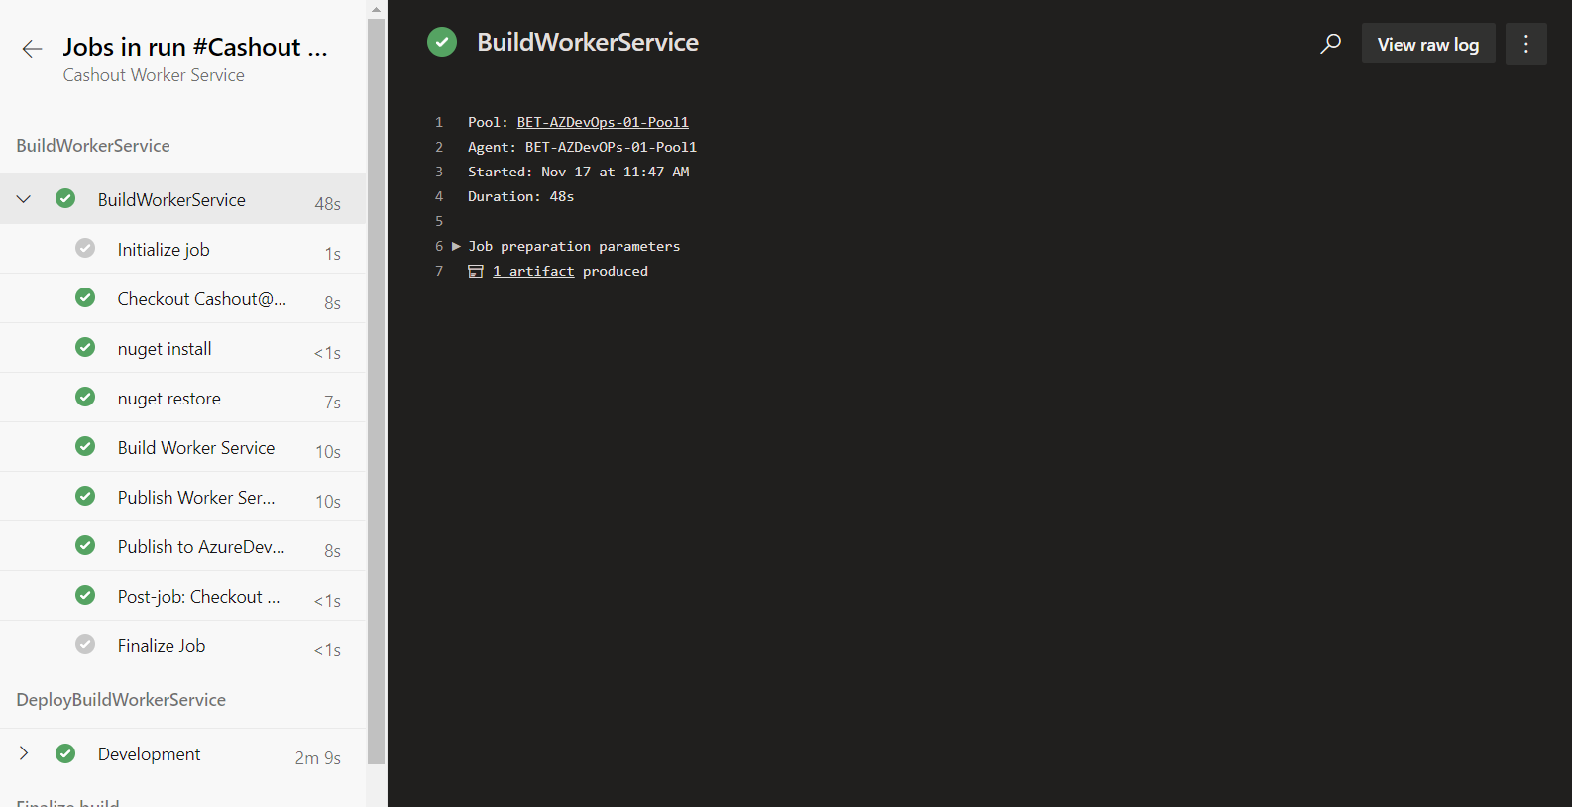
Added Intelligence

Slide 9
The End…

